Slide 1
CSC 250: Foundations of Computer Science I
Fall 2023 - Lecture 7
Amitabha Dey
Department of Computer Science
University of North Carolina at Greensboro

Slide 2
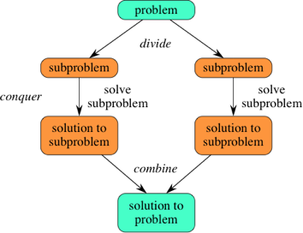
Divide and Conquer
A divide-and-conquer algorithm recursively breaks down a problem into two or more sub-problems of the same or related type, until these become simple enough to be solved directly. The solutions to the sub-problems are then combined to give a solution to the original problem.
You should think of a divide-and-conquer algorithm as having three parts:
Divide the problem into a number of subproblems that are smaller instances of the same problem.
Conquer the subproblems by solving them recursively. If they are small enough, solve the subproblems as base cases.
Combine the solutions to the subproblems into the solution for the original problem.
The divide-and-conquer technique is the basis of efficient algorithms for many problems, such as sorting (e.g., quicksort, merge sort), multiplying large numbers (e.g., the Karatsuba algorithm), finding the closest pair of points, syntactic analysis (e.g., top-down parsers), and computing the discrete Fourier transform (FFT).
Image credit - https://www.khanacademy.org/

Slide 3
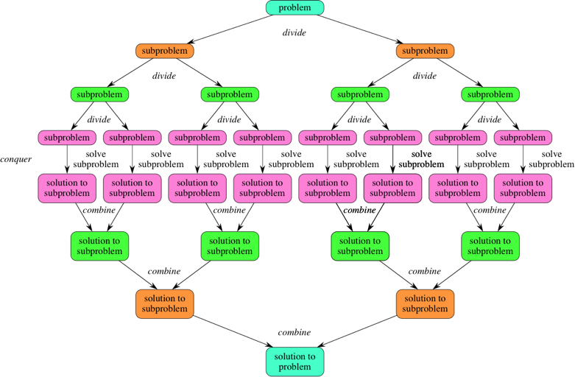
Divide and Conquer
You should think of a divide-and-conquer algorithm as having three parts:
Divide the problem into a number of subproblems that are smaller instances of the same problem.
Conquer the subproblems by solving them recursively. If they are small enough, solve the subproblems as base cases.
Combine the solutions to the subproblems into the solution for the original problem.
The divide-and-conquer technique is the basis of efficient algorithms for many problems, such as sorting (e.g., quicksort, merge sort), multiplying large numbers (e.g., the Karatsuba algorithm), finding the closest pair of points, syntactic analysis (e.g., top-down parsers), and computing the discrete Fourier transform (FFT).
Image credit - https://www.khanacademy.org/

Slide 4
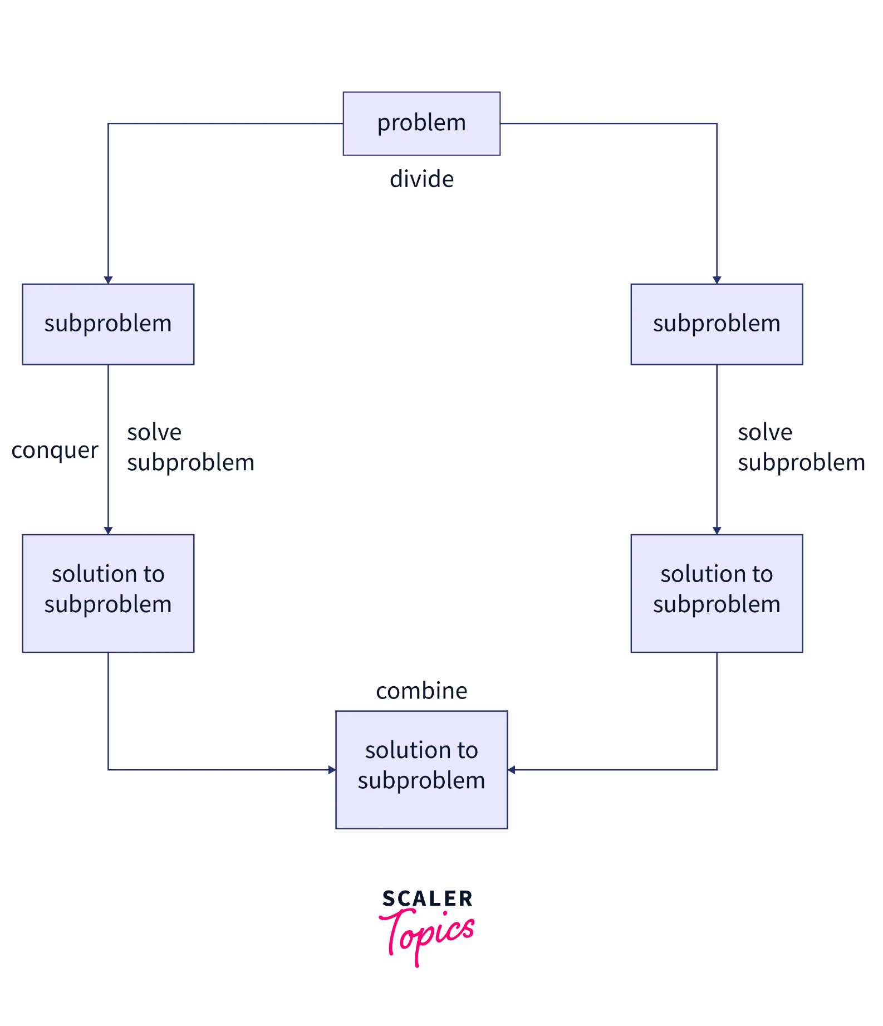
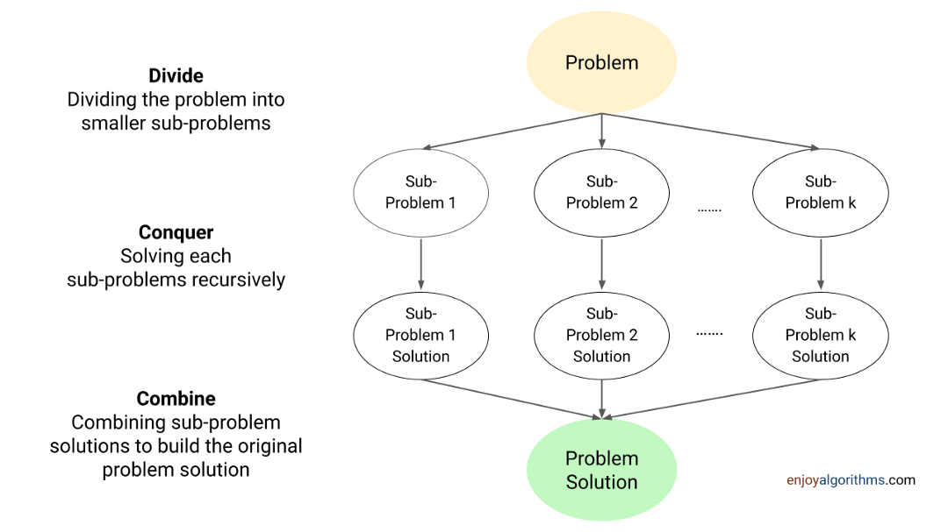
Divide and Conquer
Implementation
Image credit - https://www.enjoyalgorithms.com/
Image credit - https://www.scaler.com/

Slide 5
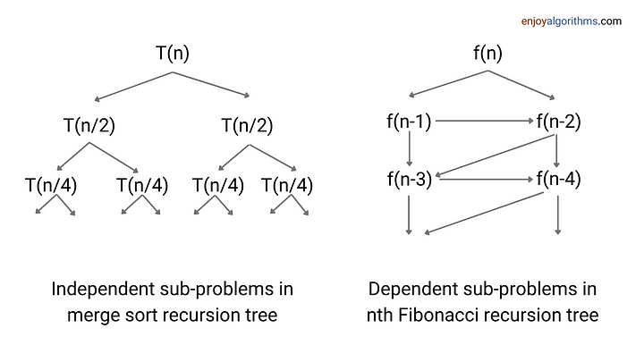
Divide and Conquer
DAC vs Dynamic Programming
When dealing with subdivisions and conquer, divide and conquer are independent of one another, whereas dynamic programming is interdependent.
A divide and conquer problem is twice as time-consuming as a dynamic programming one because each issue is independently addressed. With dynamic programming, the answers to previous questions are used.
Dynamic programming is faster than divide and conquer because it is more efficient.
Matrix chain multiplication and binary search tree optimization are performed via dynamic programming, whilst merge sort, quick sort, and binary searching, matrixes use divide and conquer.
Image credit - https://www.enjoyalgorithms.com/

Slide 6
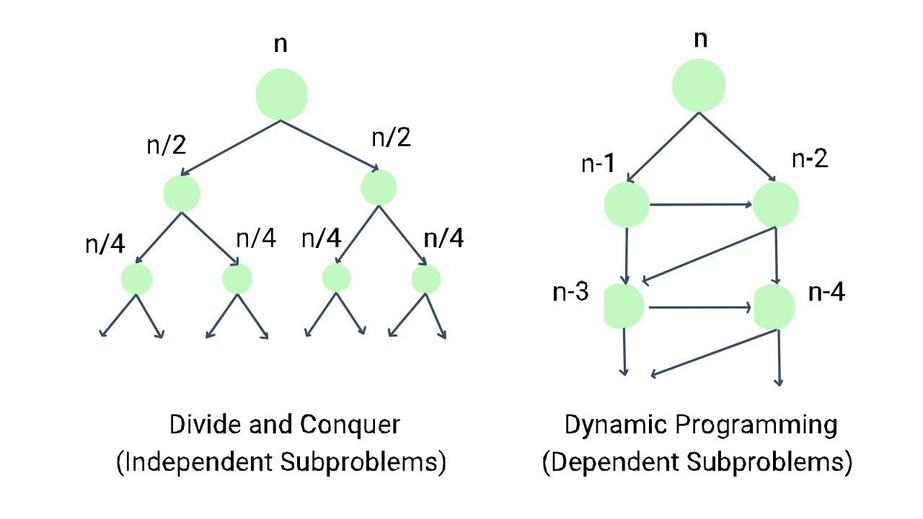
Divide and Conquer
DAC vs Dynamic Programming
In the context of algorithms, independent means that the solution to one subproblem does not affect the solution to another subproblem. So, subproblems can be solved separately. An example of this is the idea of merge sort, where we divide the input array into two equal subarrays. Then, we recursively sort these two subproblems, treating each subarray as a separate problem.
On the other hand, dependent means that the solution to one subproblem relies on the solution to one or more smaller subproblems. So, the subproblems must be solved in a specific order. An example of this is the problem of finding the nth Fibonacci. For finding the nth Fibonacci, we use the solutions of the two subproblems: Finding the (n - 1)th and (n - 2)th Fibonacci. To calculate the (n - 1)th Fibonacci, we use the solution to the (n - 2)th and (n - 3)th Fibonacci. In other words, here subproblems are dependent because we can not solve nth Fibonacci and (n - 1)th Fibonacci until we find the solution of (n-2)th Fibonacci.
Image credit - https://www.enjoyalgorithms.com/

Slide 7
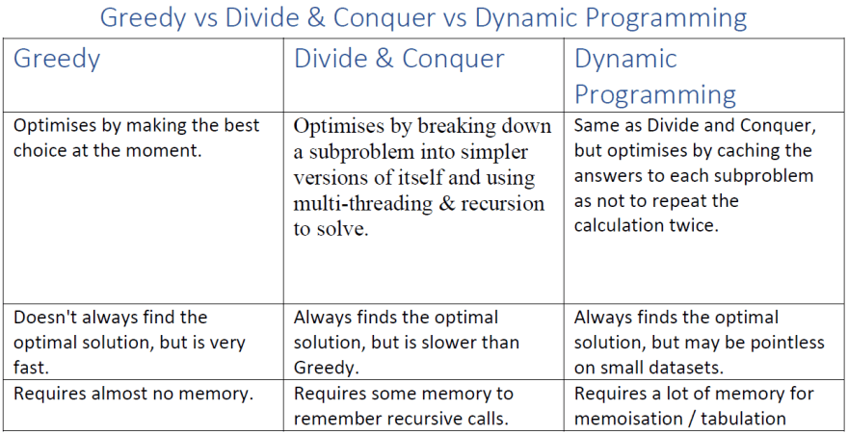
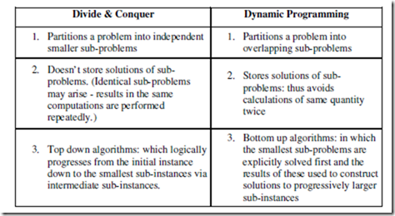
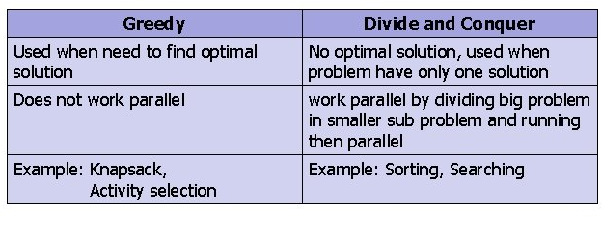
Divide and Conquer
DAC vs Dynamic vs Greedy
Image credit - https://en.differbetween.com/
Image credit - https://dev.to/
Image credit - https://slidetodoc.com/

Slide 8
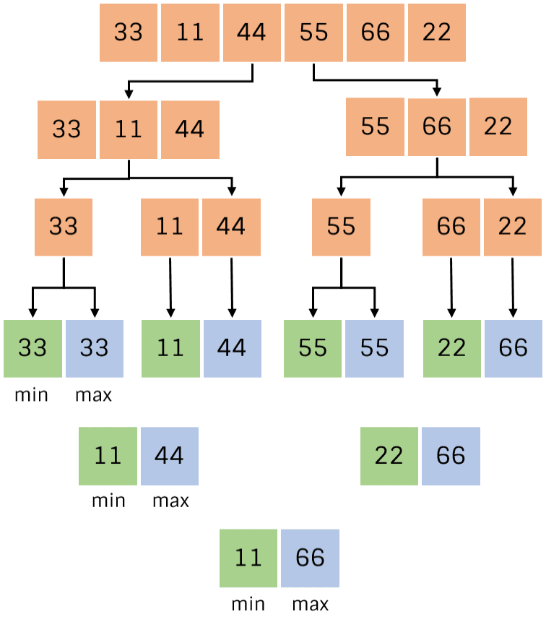
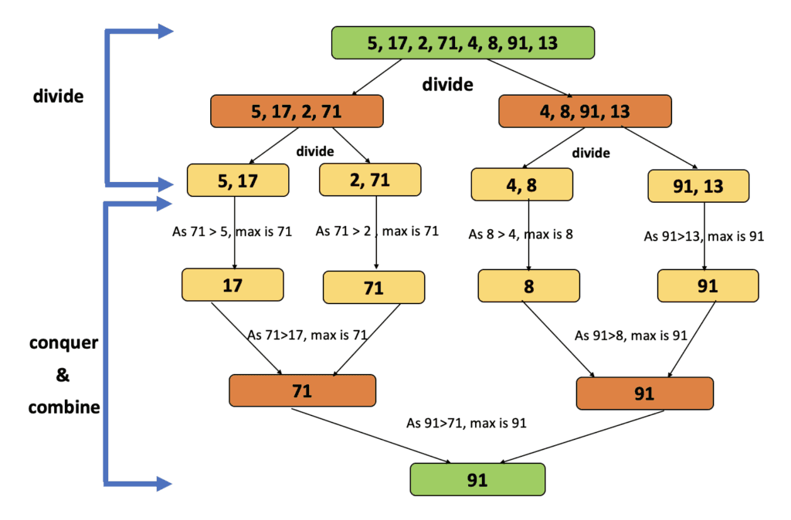
Divide and Conquer
Max Element in an Array
Divide: Divide array into two halves.
Conquer: Recursively find maximum and minimum of both halves.
Combine: Compare maximum of both halves to get overall maximum and compare minimum of both halves to get overall minimum.
Image credit - https://codecrucks.com/
Image credit - https://technologystrive.com/

Slide 9
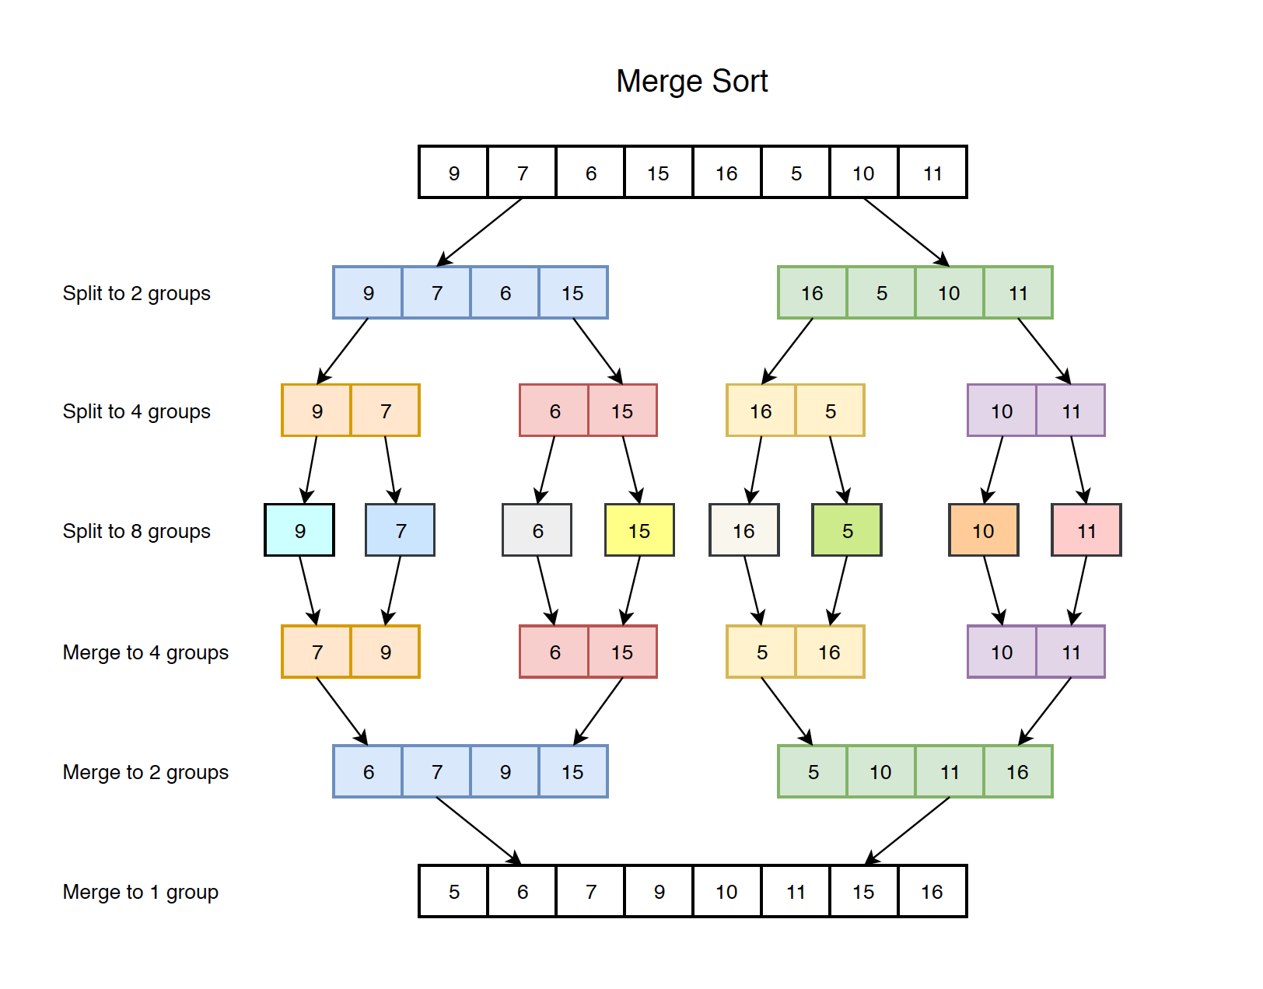
Divide and Conquer
Merge Sort Algorithm
Merge sort is a sorting algorithm that works by dividing an array into smaller subarrays, sorting each subarray, and then merging the sorted subarrays back together to form the final sorted array.
In simple terms, we can say that the process of merge sort is to divide the array into two halves, sort each half, and then merge the sorted halves back together. This process is repeated until the entire array is sorted.
Think of it as a recursive algorithm continuously splits the array in half until it cannot be further divided. This means that if the array becomes empty or has only one element left, the dividing will stop, i.e. it is the base case to stop the recursion. If the array has multiple elements, split the array into halves and recursively invoke the merge sort on each of the halves.
Finally, when both halves are sorted, the merge operation is applied. Merge operation is the process of taking two smaller sorted arrays and combining them to eventually make a larger one.
Image credit - https://jojozhuang.github.io/

Slide 10
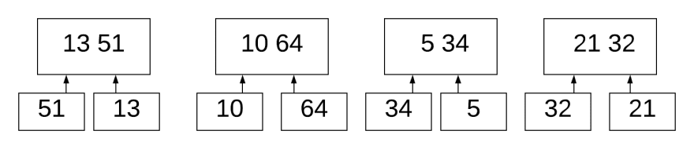
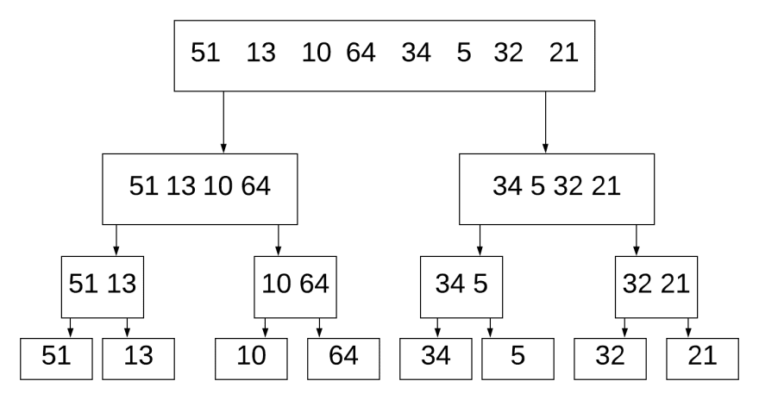
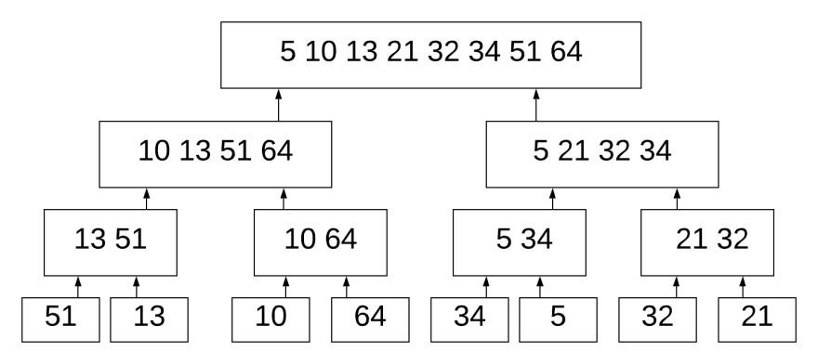
Divide and Conquer
Merge Sort Algorithm
We break down the 8 numbers into separate digits. It compares 51 and 13. Since 13 is smaller, it puts it in the left-hand side. It does this for (10, 64), (34, 5), (32, 21).
The algorithm works as follows:
Divide the sequence of n numbers into 2 halves
Recursively sort the two halves
Merge the two sorted halves into a single sorted sequence
It then merges (13, 51) with (10, 64). It knows that 13 is the smallest in the first list, and 10 is the smallest in the right list. 10 is smaller than 13, therefore we don't need to compare 13 to 64. We're comparing & merging two sorted lists.
Image credit - https://dev.to/

Slide 11
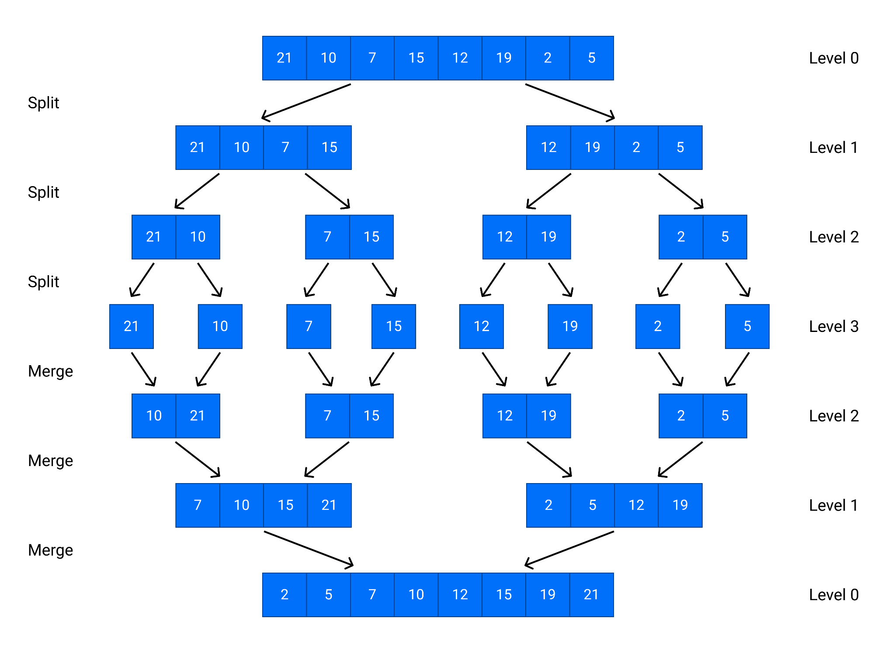
Divide and Conquer
Quick Sort Algorithm
Quicksort uses divide-and-conquer, and so it's a recursive algorithm.
The way that quicksort uses divide-and-conquer is a little different from how merge sort does.
In merge sort, the divide step does hardly anything, and all the real work happens in the combine step.
Quicksort is the opposite: all the real work happens in the divide step. In fact, the combine step in quicksort does absolutely nothing.
Image credit - https://dev.to/

Slide 12
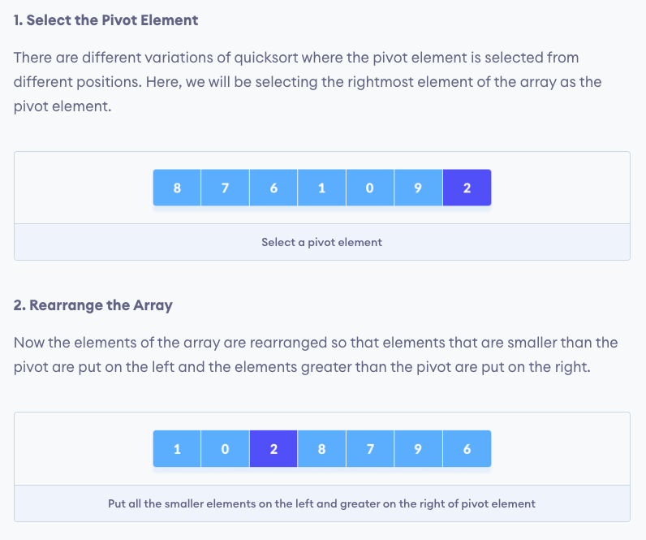
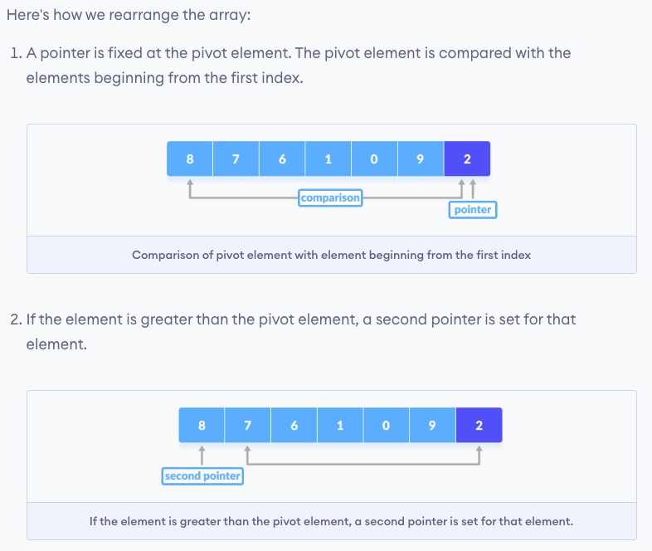
Divide and Conquer
Quick Sort Algorithm
Image credit - https://www.programiz.com/

Slide 13
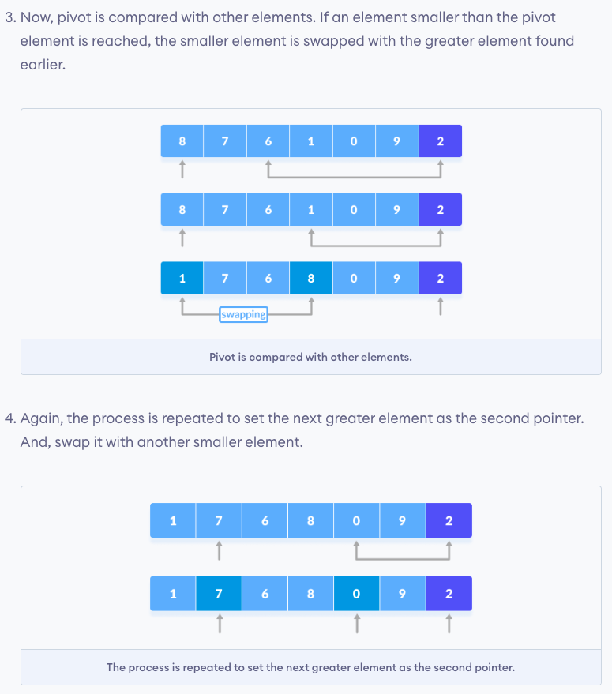
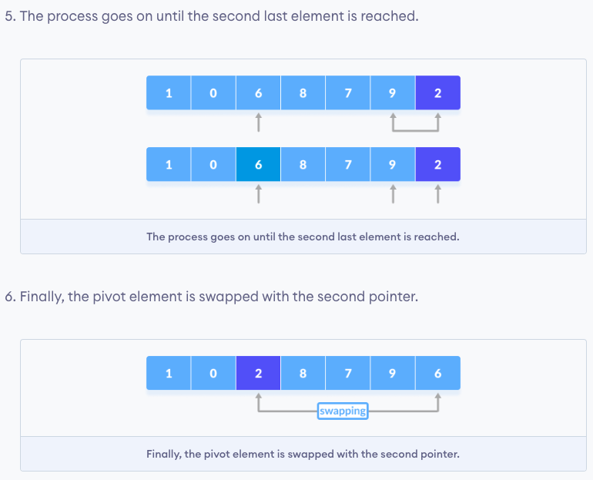
Divide and Conquer
Quick Sort Algorithm
Image credit - https://www.programiz.com/

Slide 14
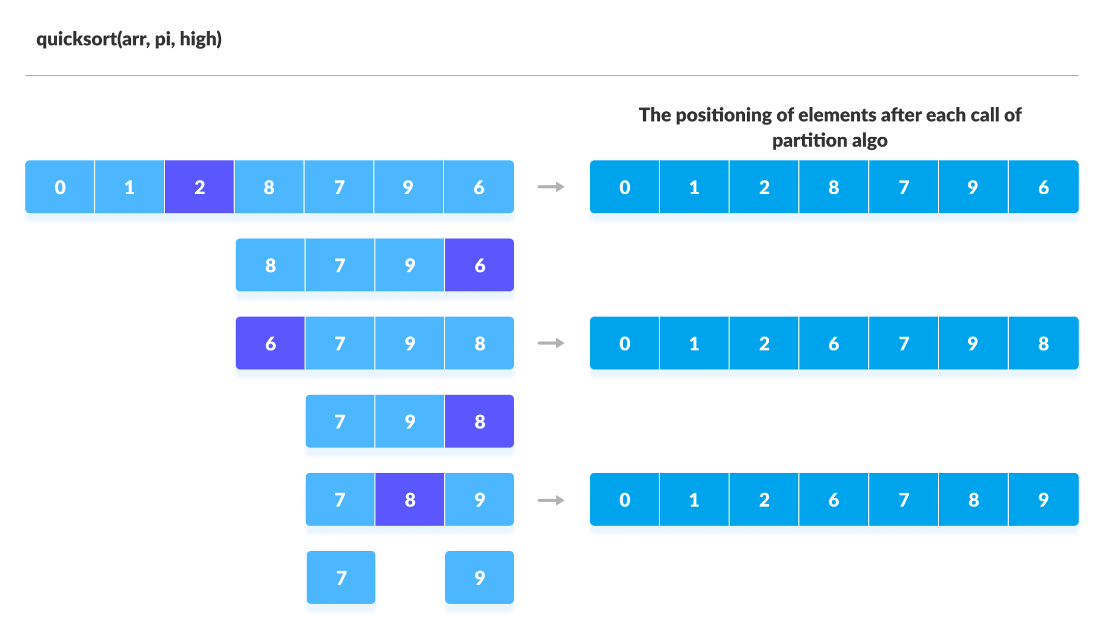
Divide and Conquer
Quick Sort Algorithm
Image credit - https://www.programiz.com/

Slide 15
Divide and Conquer
Binary Search Algorithm
Divide Phase
In the divide phase of Binary Search, the algorithm splits the search space in half. It calculates the middle index of the array and compares the target element with the element at the middle index. This comparison determines which half of the array is more likely to contain the target element.
If the target element is equal to the middle element, the search is successful, and the algorithm terminates. Otherwise, if the target element is less than the middle element, the algorithm narrows down the search space to the left half of the array. Similarly, if the target element is greater than the middle element, the algorithm focuses on the right half of the array.
The divide phase involves dividing the problem into smaller subproblems by selecting the appropriate half of the array. This step plays a crucial role in reducing the search space and optimizing the search process.
Conquer Phase
In the conquer phase of Binary Search, the algorithm recursively applies the divide and conquer paradigm to the selected half of the array. It continues the search process on the reduced search space until the target element is found or the search space is exhausted.
By repeatedly dividing the search space and applying the divide and conquer approach, Binary Search efficiently homes in on the target element. The conquer phase involves solving the subproblems independently and combining their solutions to obtain the final result, which in this case is finding the target element.

Slide 16
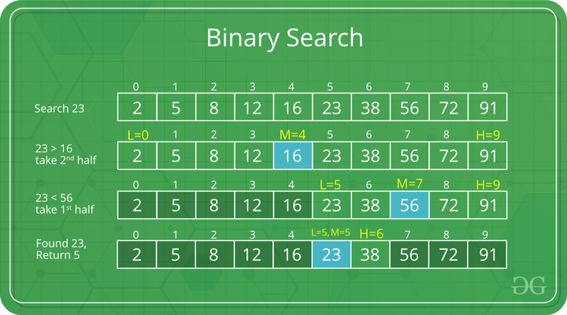
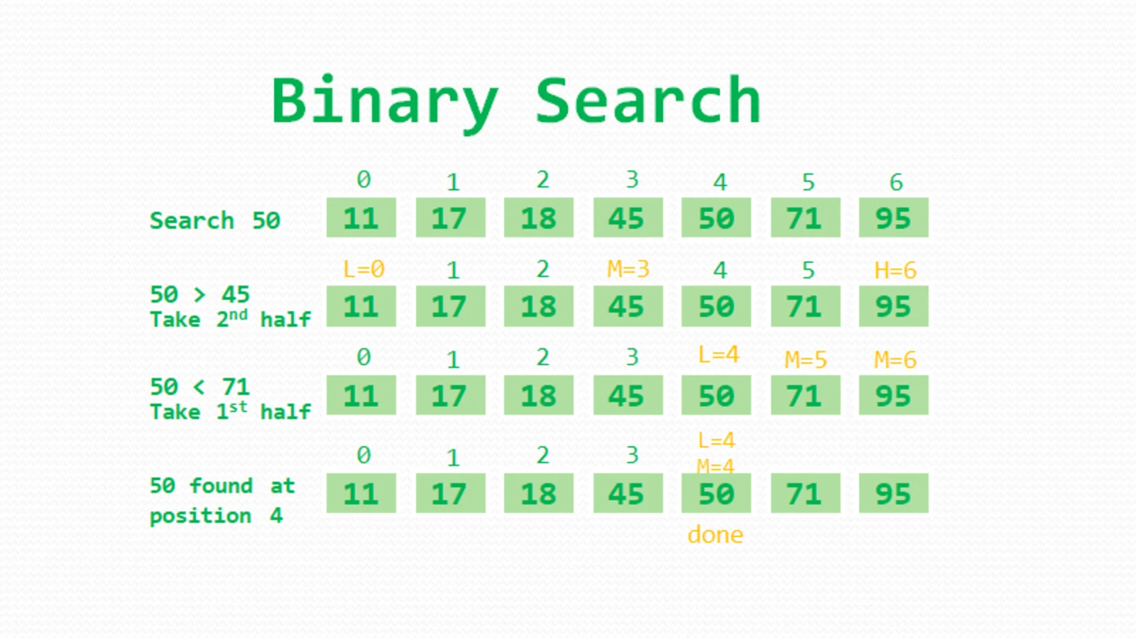
Divide and Conquer
Binary Search Algorithm
Image credit - https://dev.to/
Image credit - https://www.geeksforgeeks.org/

Slide 17
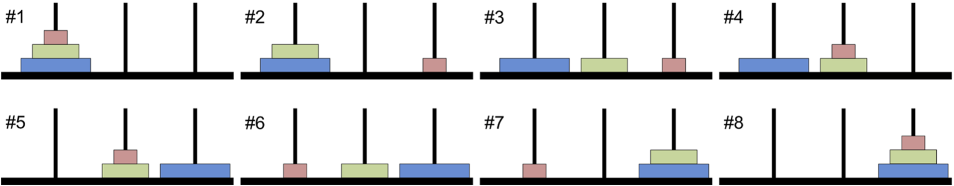
Divide and Conquer
Towers of Hanoi
The Towers of Hanoi problem consists of three vertical rods, or towers, and N disks of different sizes, each with a hole in the center so that the rod can slide through it. The disks are originally stacked on one of the towers in order of descending size (i.e., the largest disc is on the bottom). The goal of the problem is to move all the disks to a different rod while complying with the following three rules:
Only one disk can be moved at a time.
Only the disk at the top of a stack may be moved.
A disk may not be placed on top of a smaller disk.
The following figure shows the steps of the solution to the Tower of Hanoi problem with three disks.
Image credit - https://pythonnumericalmethods.berkeley.edu/

Slide 18
Divide and Conquer
Towers of Hanoi
The Towers of Hanoi problem consists of three vertical rods, or towers, and N disks of different sizes, each with a hole in the center so that the rod can slide through it. The disks are originally stacked on one of the towers in order of descending size (i.e., the largest disc is on the bottom). The goal of the problem is to move all the disks to a different rod while complying with the following three rules:
Only one disk can be moved at a time.
Only the disk at the top of a stack may be moved.
A disk may not be placed on top of a smaller disk.
The following figure shows the steps of the solution to the Tower of Hanoi problem with three disks.
A legend goes that a group of Indian monks are in a monastery working to complete a Towers of Hanoi problem with 64 disks. When they complete the problem, the world will end.
Fortunately, the number of moves required is 2^64−1 seconds, so even if they could move one disk per millisecond, it would take over 585 billion years for them to finish, which is about 42 times the estimated current age of the universe!
Image credit - https://pythonnumericalmethods.berkeley.edu/

Slide 19
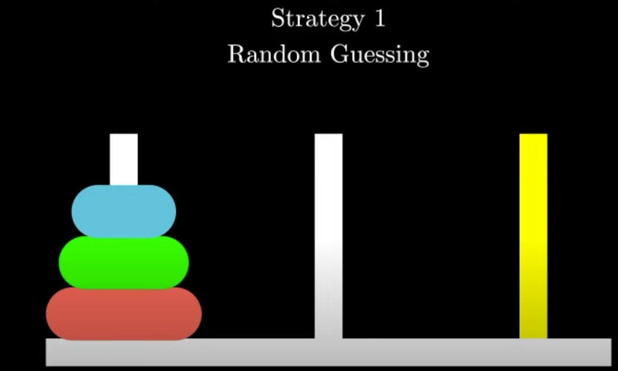
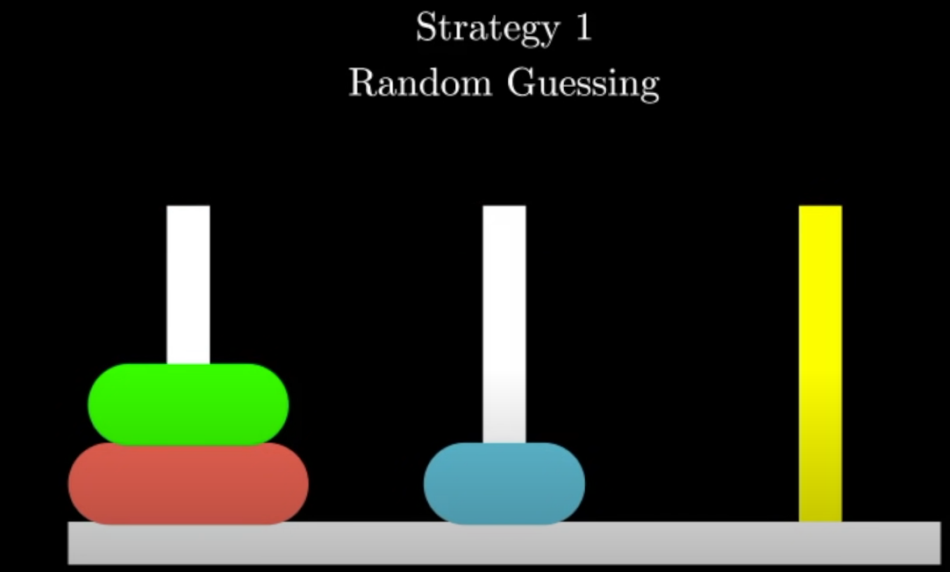
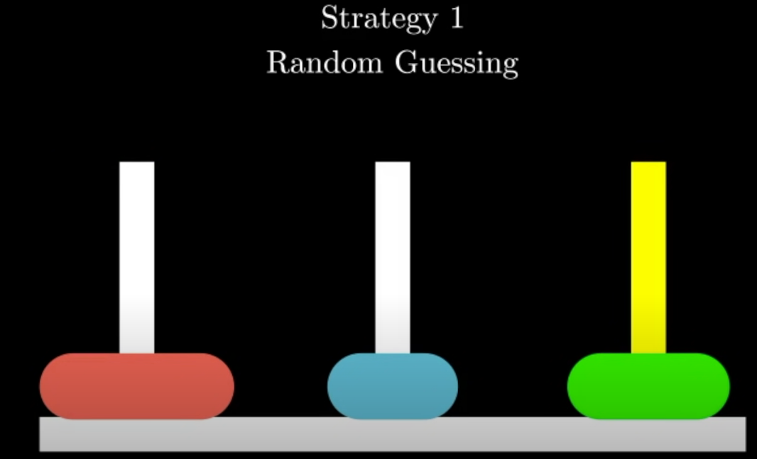
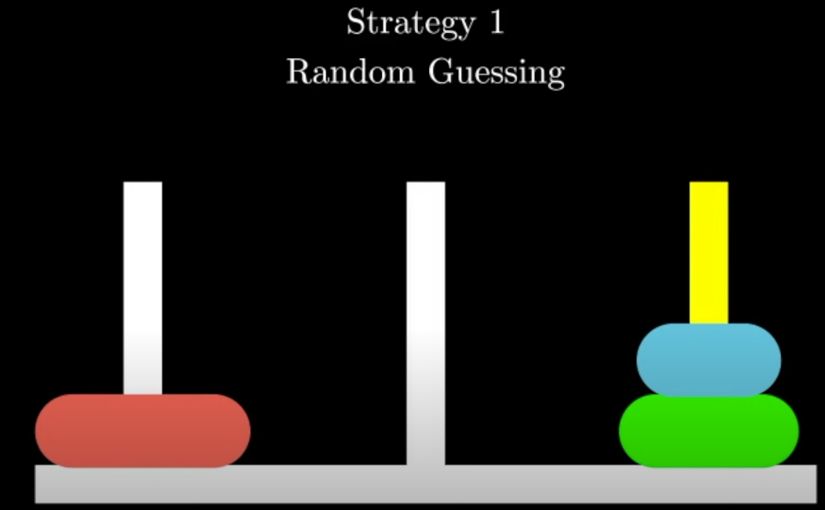
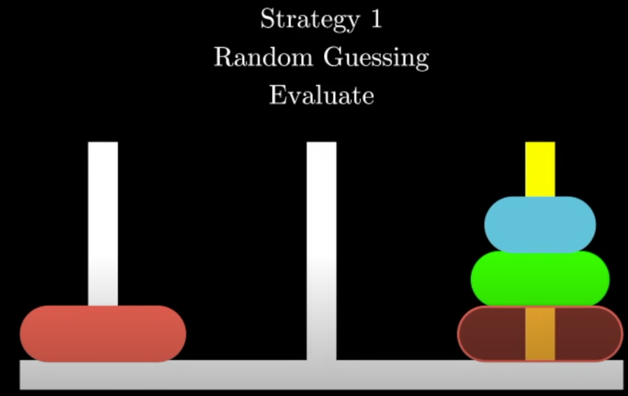
Divide and Conquer
Towers of Hanoi
Image credit - Reducible on YouTube
We realize we are not getting anywhere. This is what we really want

Slide 20
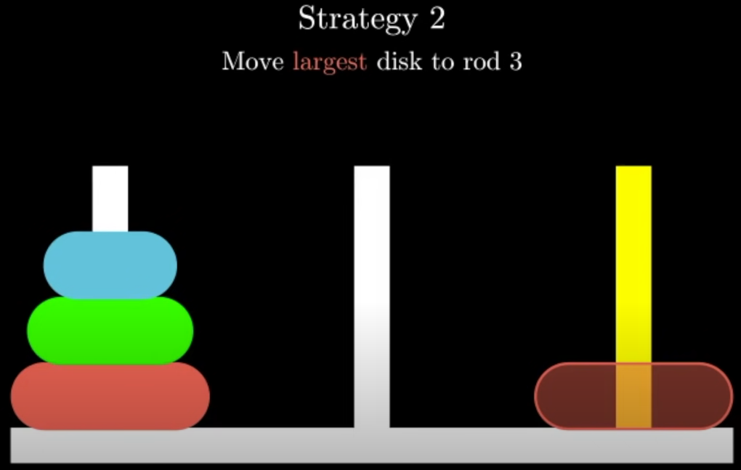
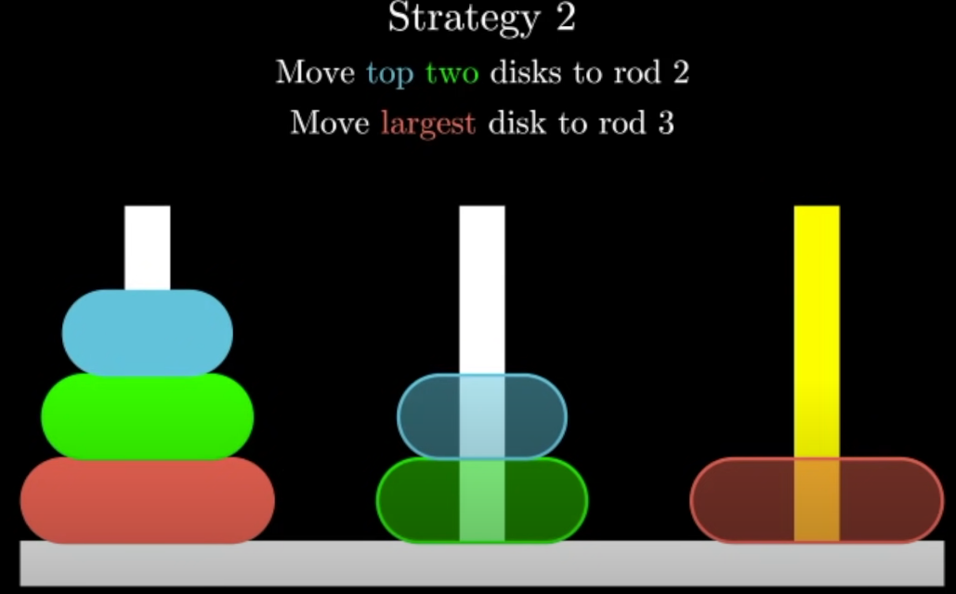
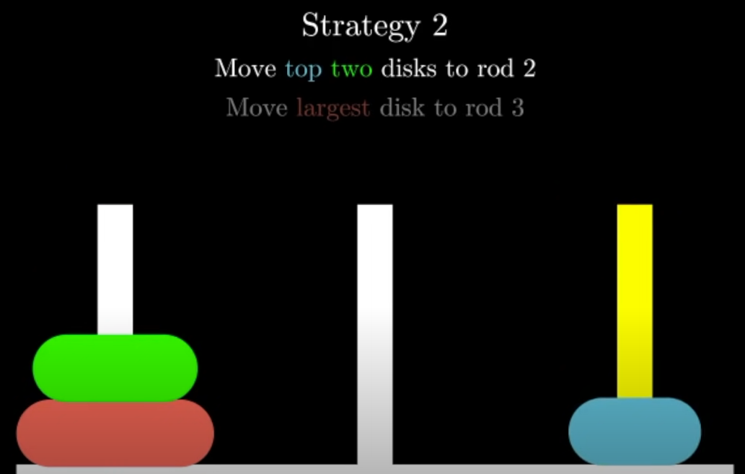
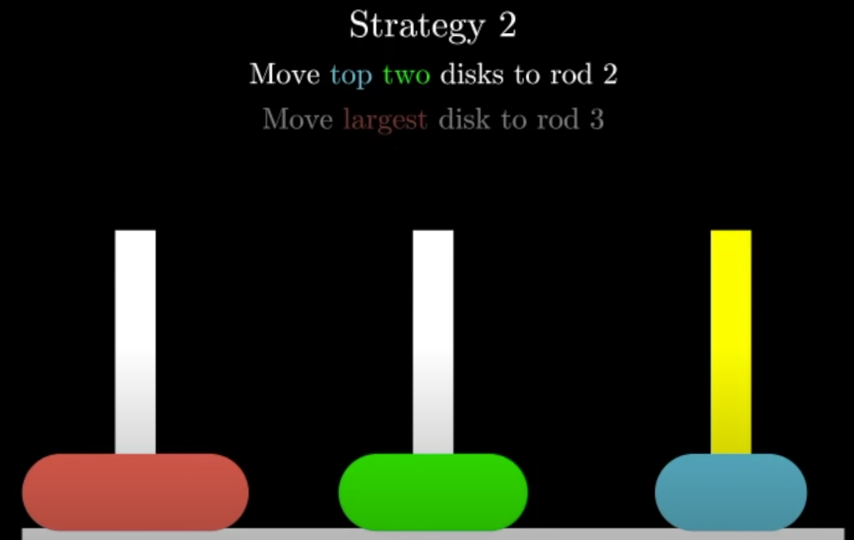
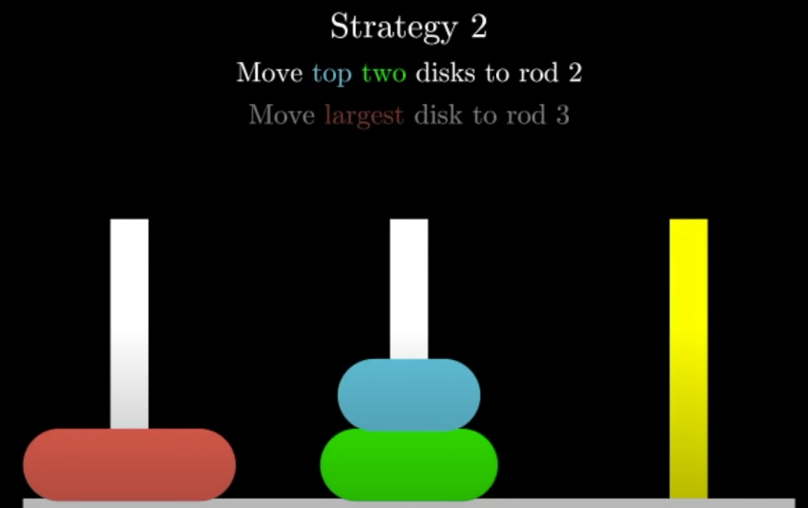
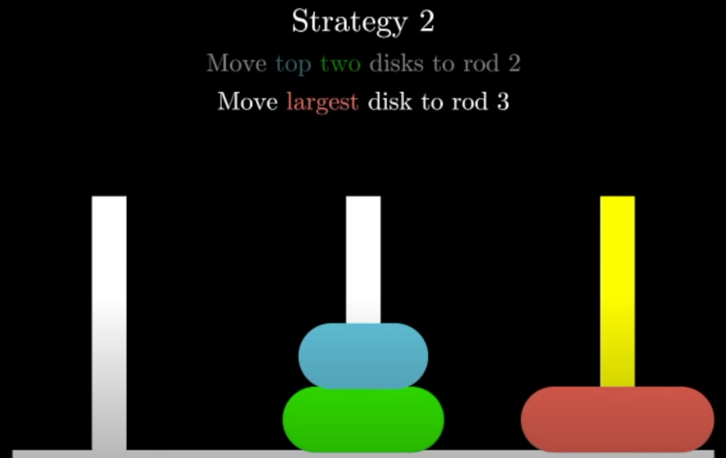
Divide and Conquer
Towers of Hanoi
Image credit - Reducible on YouTube

Slide 21
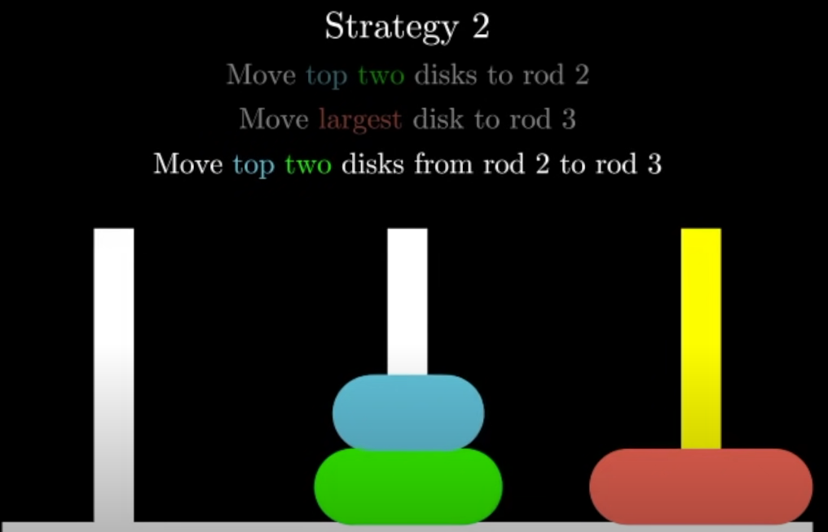
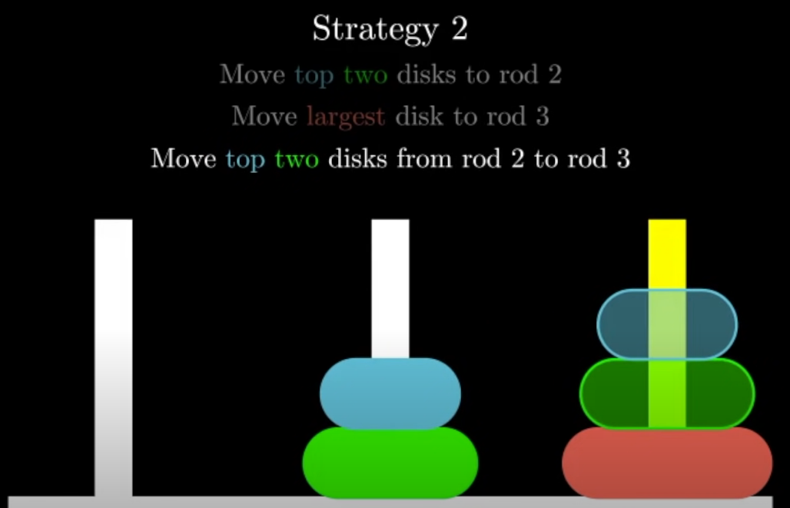
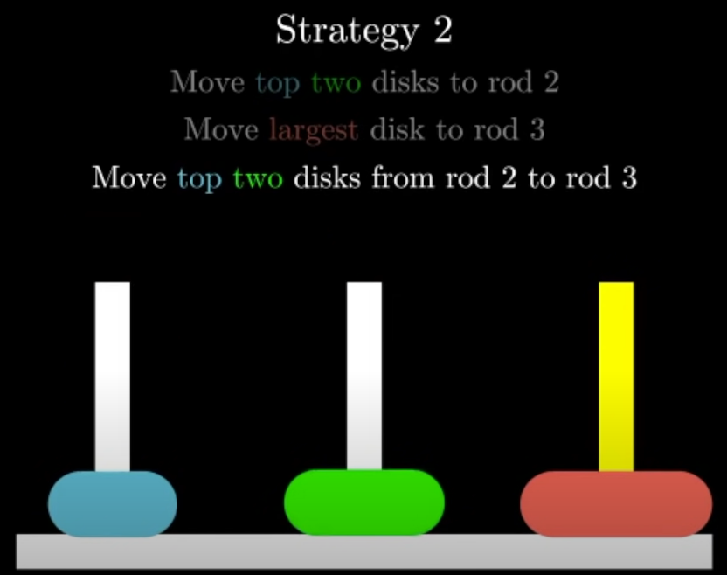
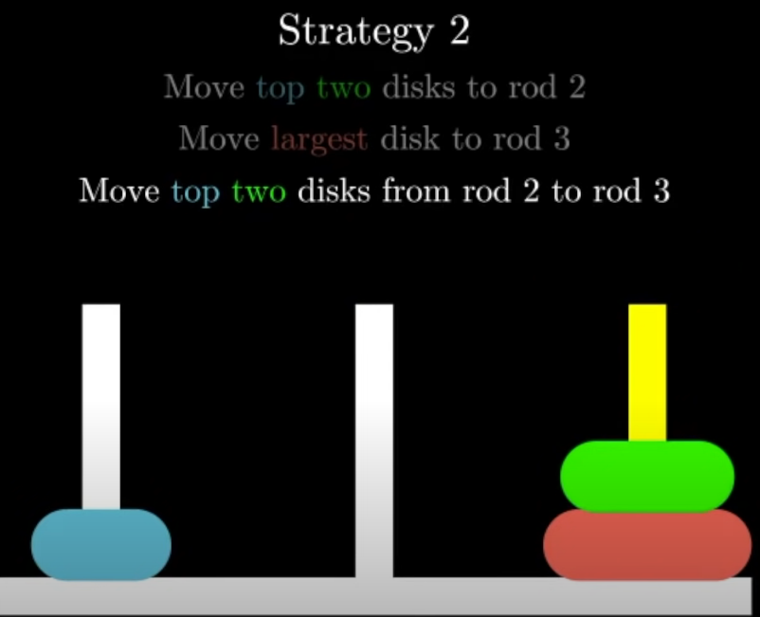
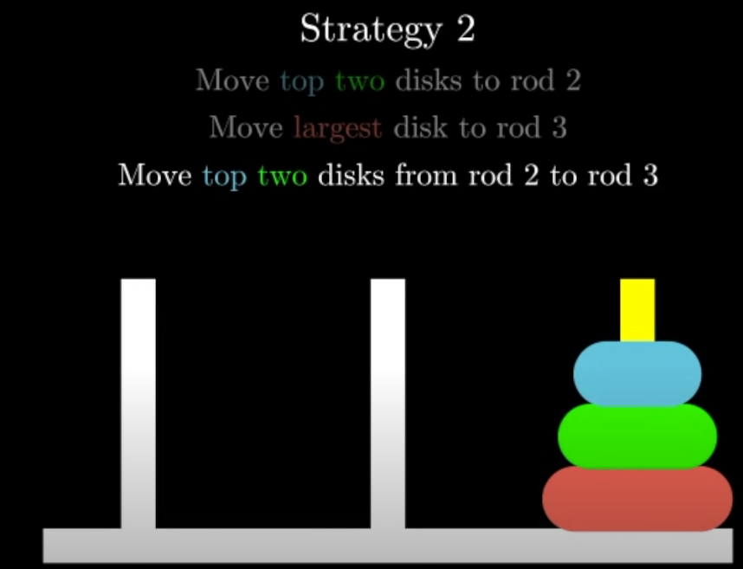
Divide and Conquer
Towers of Hanoi
Image credit - Reducible on YouTube
We just solved Towers of Hanoi for 3 discs! 🎉

Slide 22
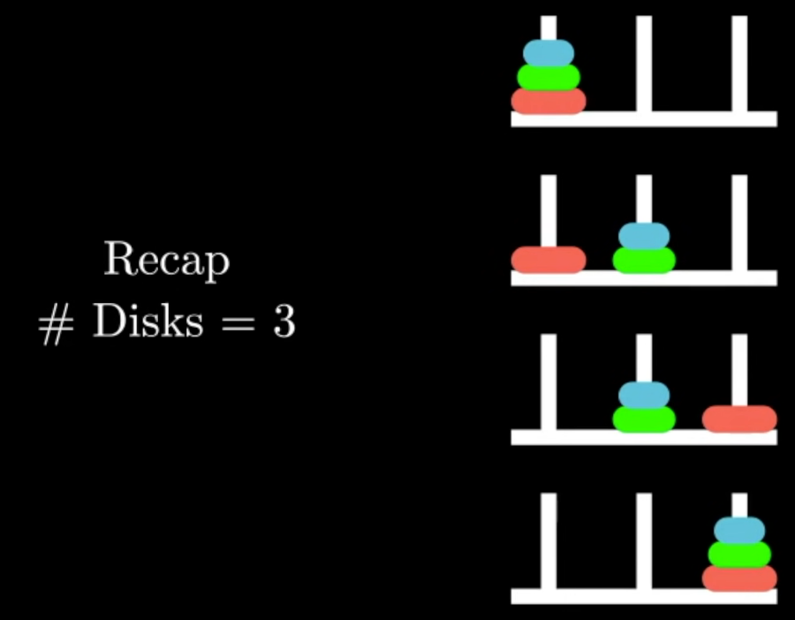
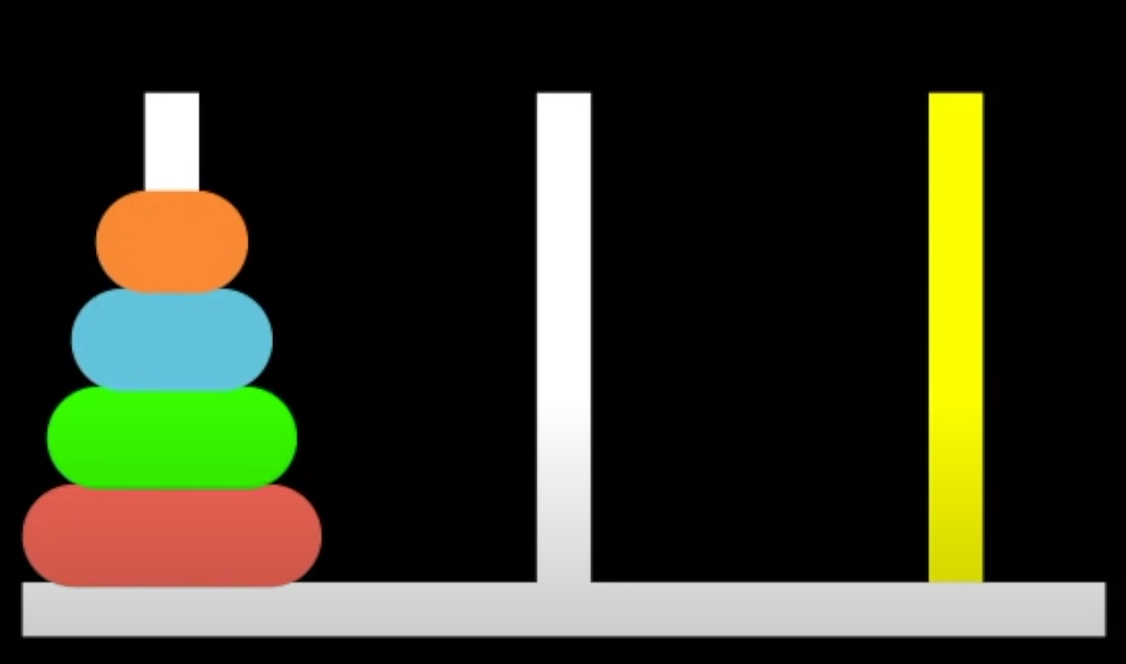
Divide and Conquer
Towers of Hanoi
Image credit - Reducible on YouTube
We first found a way to move the top 2 discs to the second rod
Allowing us to move the largest disc to the destination rod
Finally, we move the top 2 discs from the middle rod to the destination rod
Can we utilize the same strategy to move 4 discs?

Slide 23
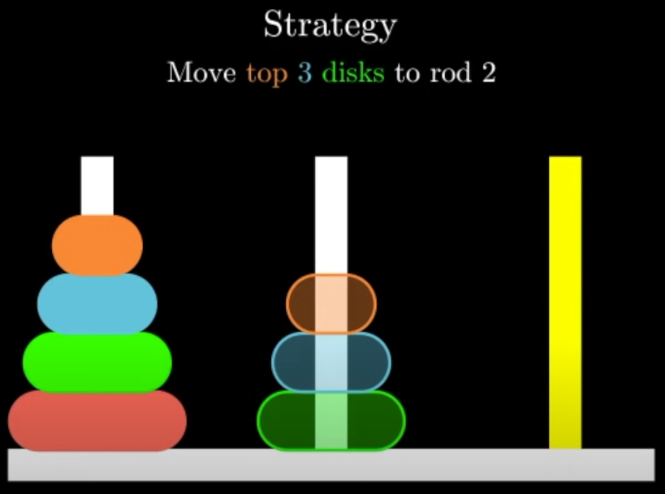
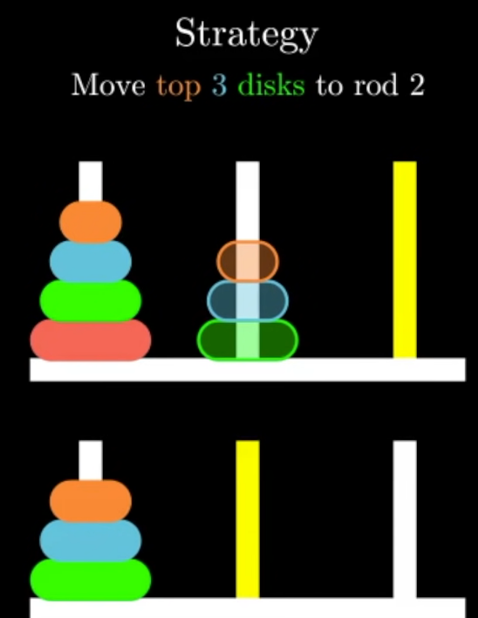
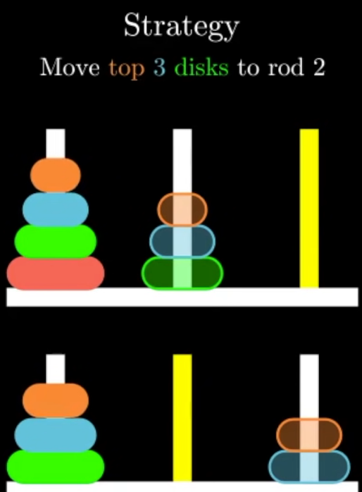
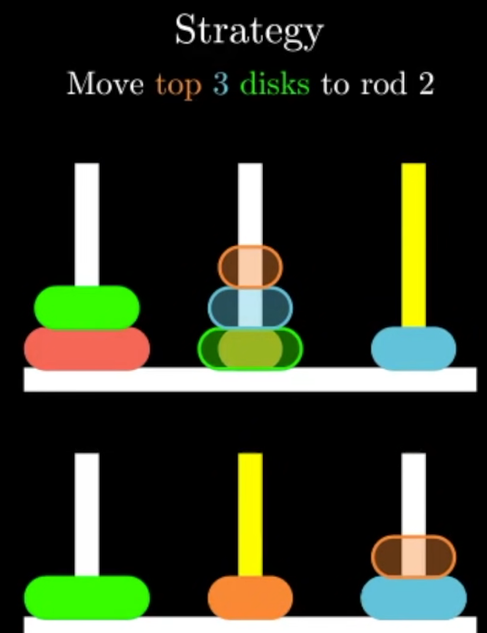
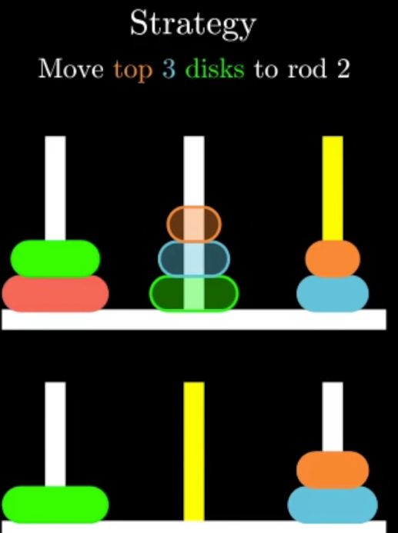
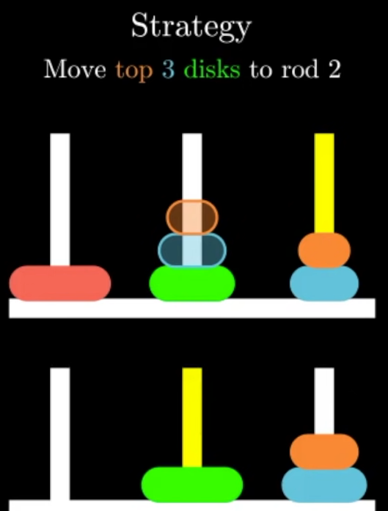
Divide and Conquer
Towers of Hanoi
Image credit - Reducible on YouTube
You can think of this problem as a 3 disc Tower of Hanoi problem and consider the middle rod as the destination rod.

Slide 24
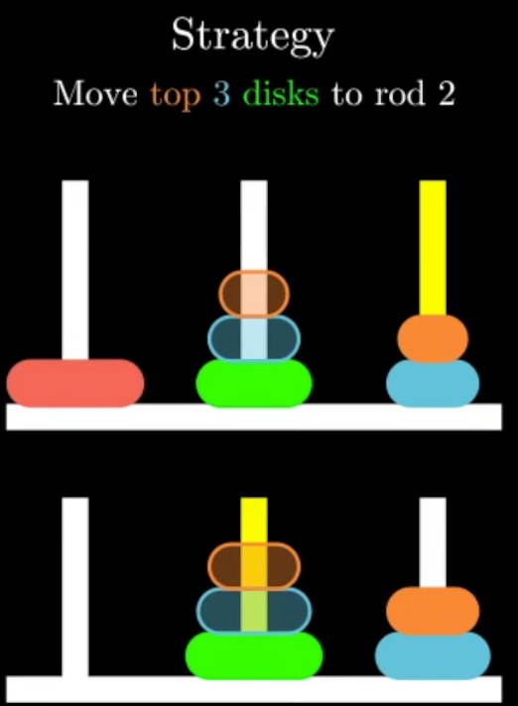
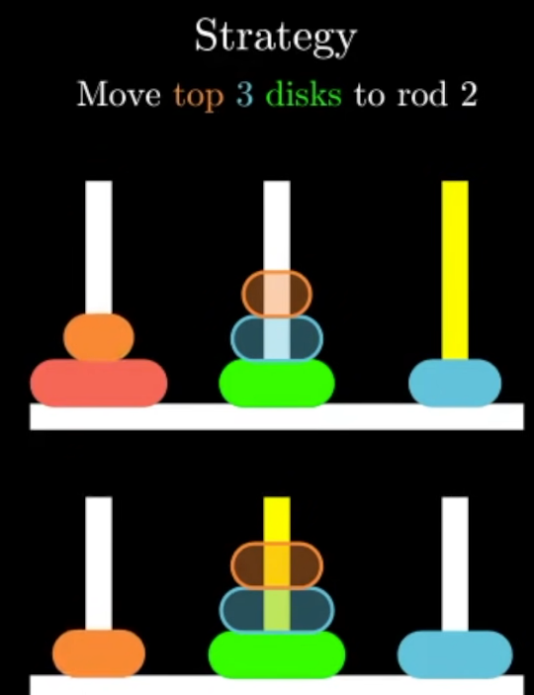


Divide and Conquer
Towers of Hanoi
Image credit - Reducible on YouTube

Slide 25


Divide and Conquer
Towers of Hanoi
Image credit - Reducible on YouTube

Slide 26




Divide and Conquer
Towers of Hanoi
Image credit - Reducible on YouTube

Slide 27

Divide and Conquer
Towers of Hanoi
Image credit - Reducible on YouTube
We first moved the top 3 discs from rod 1 to rod 2
This involved a couple of intermediate steps -
We first moved the top 2 discs from rod 1 to rod 3
We moved the largest rod (largest in the subtask) from rod 1 to rod 2
Then we move the top 2 disks back from rod 3 to rod 2
We are then free to move the largest disk from rod 1 to the destination rod
We use similar subtasks to move the top 3 disks from the middle rod to the destination rod on top of the largest rod.

